Slide 1
MHS
MOBILE HARDWARE SAMPLER

Slide 2
PROBLEM ANALYSIS
Fast and reliable audio sampling and playback is mandatory for most music production workflows!
1. How is the audio processed to achieve this?
2. How to structure a user friendly, intuitive Interface?

Slide 3
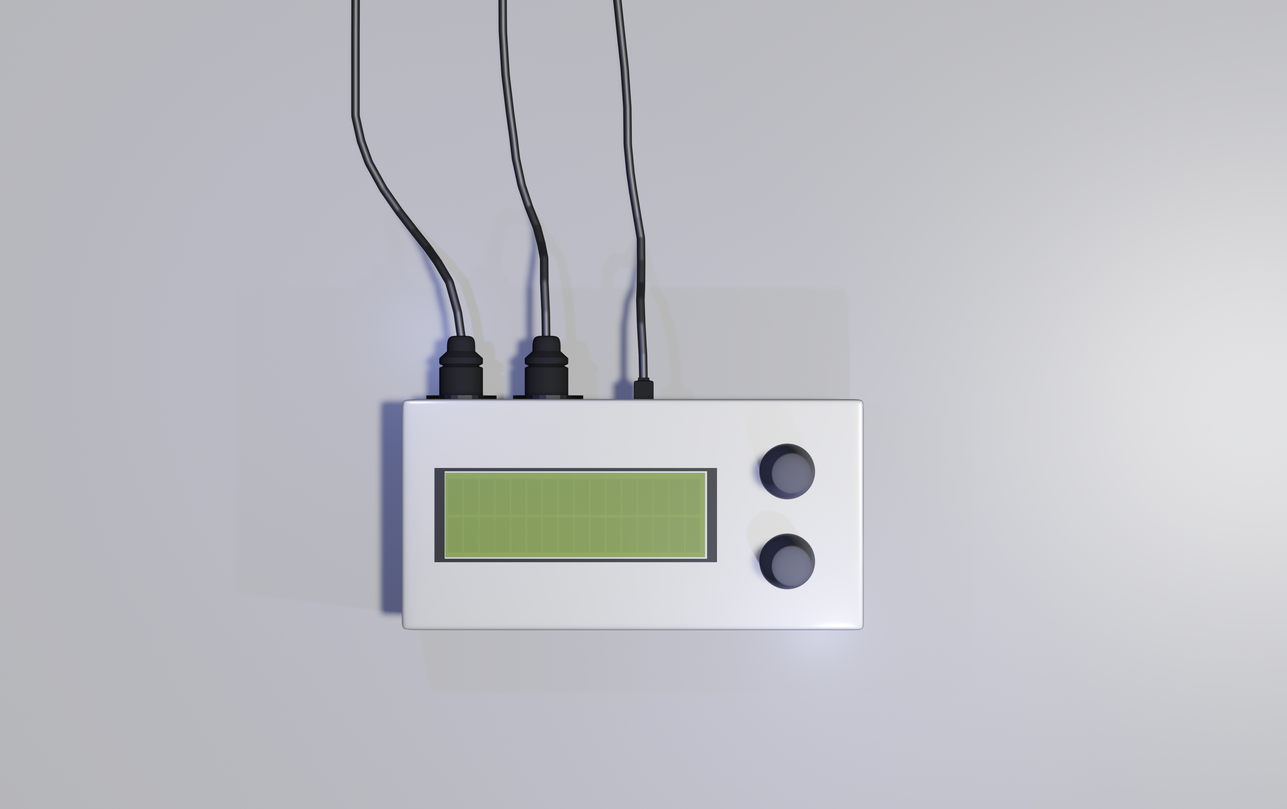
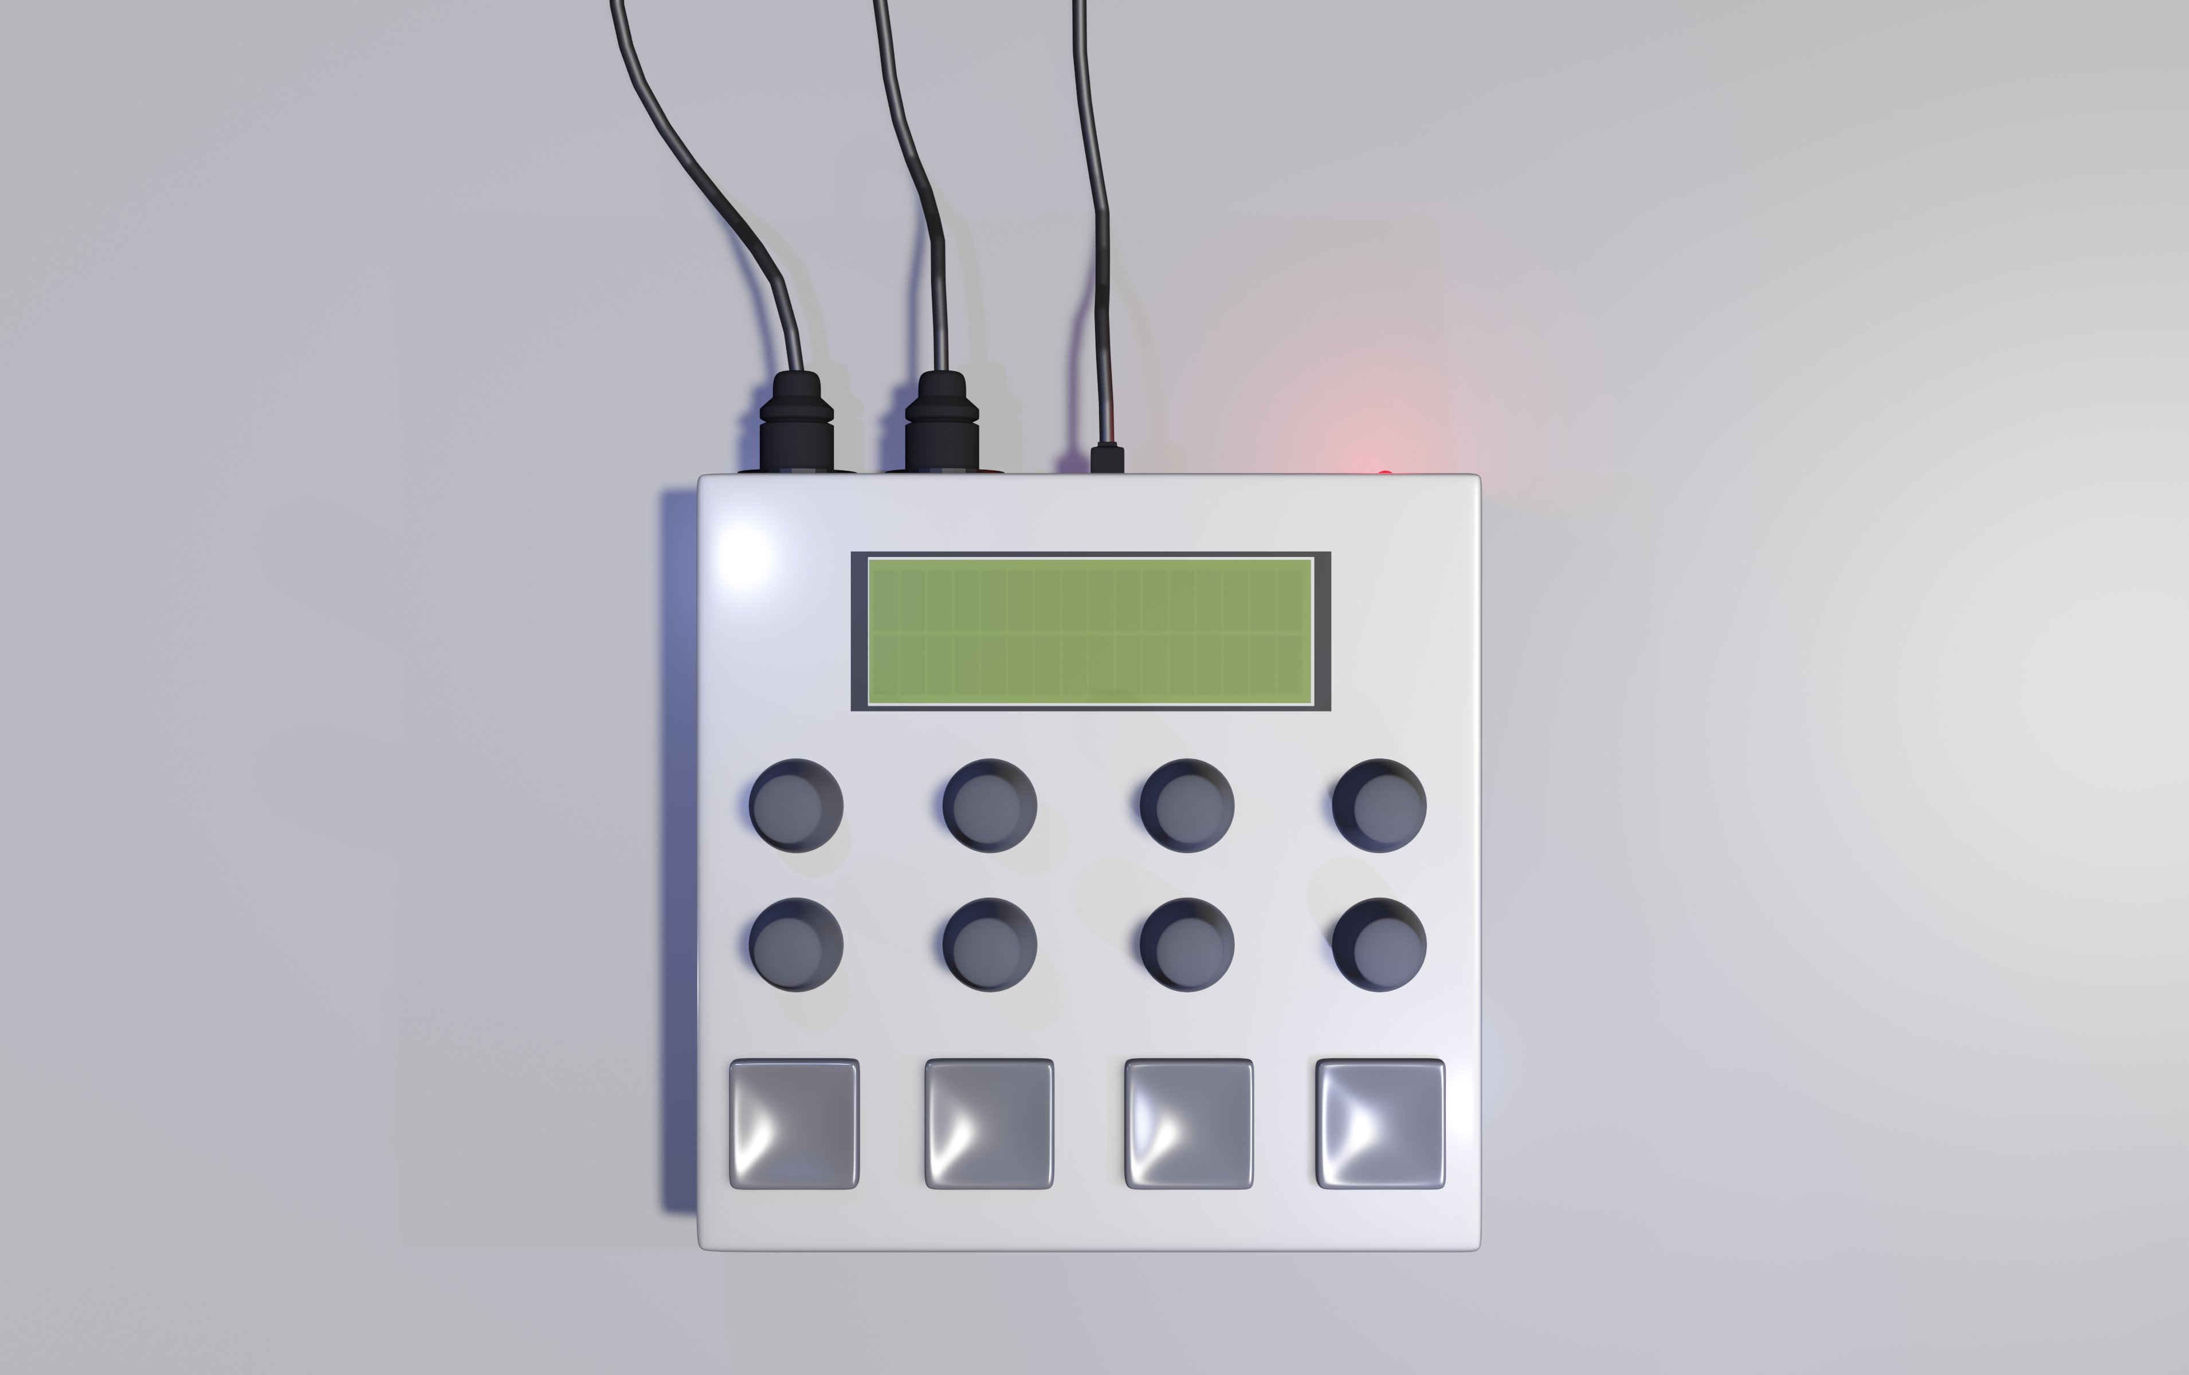
PROJECT GOAL
Building a funktional hardware sampler
Minimum
Read audio from a SD Card and load it into the RAM
Provide connectivity to other devices over MIDI and MIDI over USB
Design a simple but effective User interface
2-8 tone polyphony
Optional
Digital effects (algorythmic reverb, filters, delay …)
A line Input to directly sample on the device
Recording of a MIDI loop
Velocity sensitive pads

Slide 4
THE STAGES
01
02
03
STAGE 1
MINIMAL FEATURES
STAGE 2
OPTIONAL FEATURES
STAGE 3
BUILDING A CASE

Slide 5
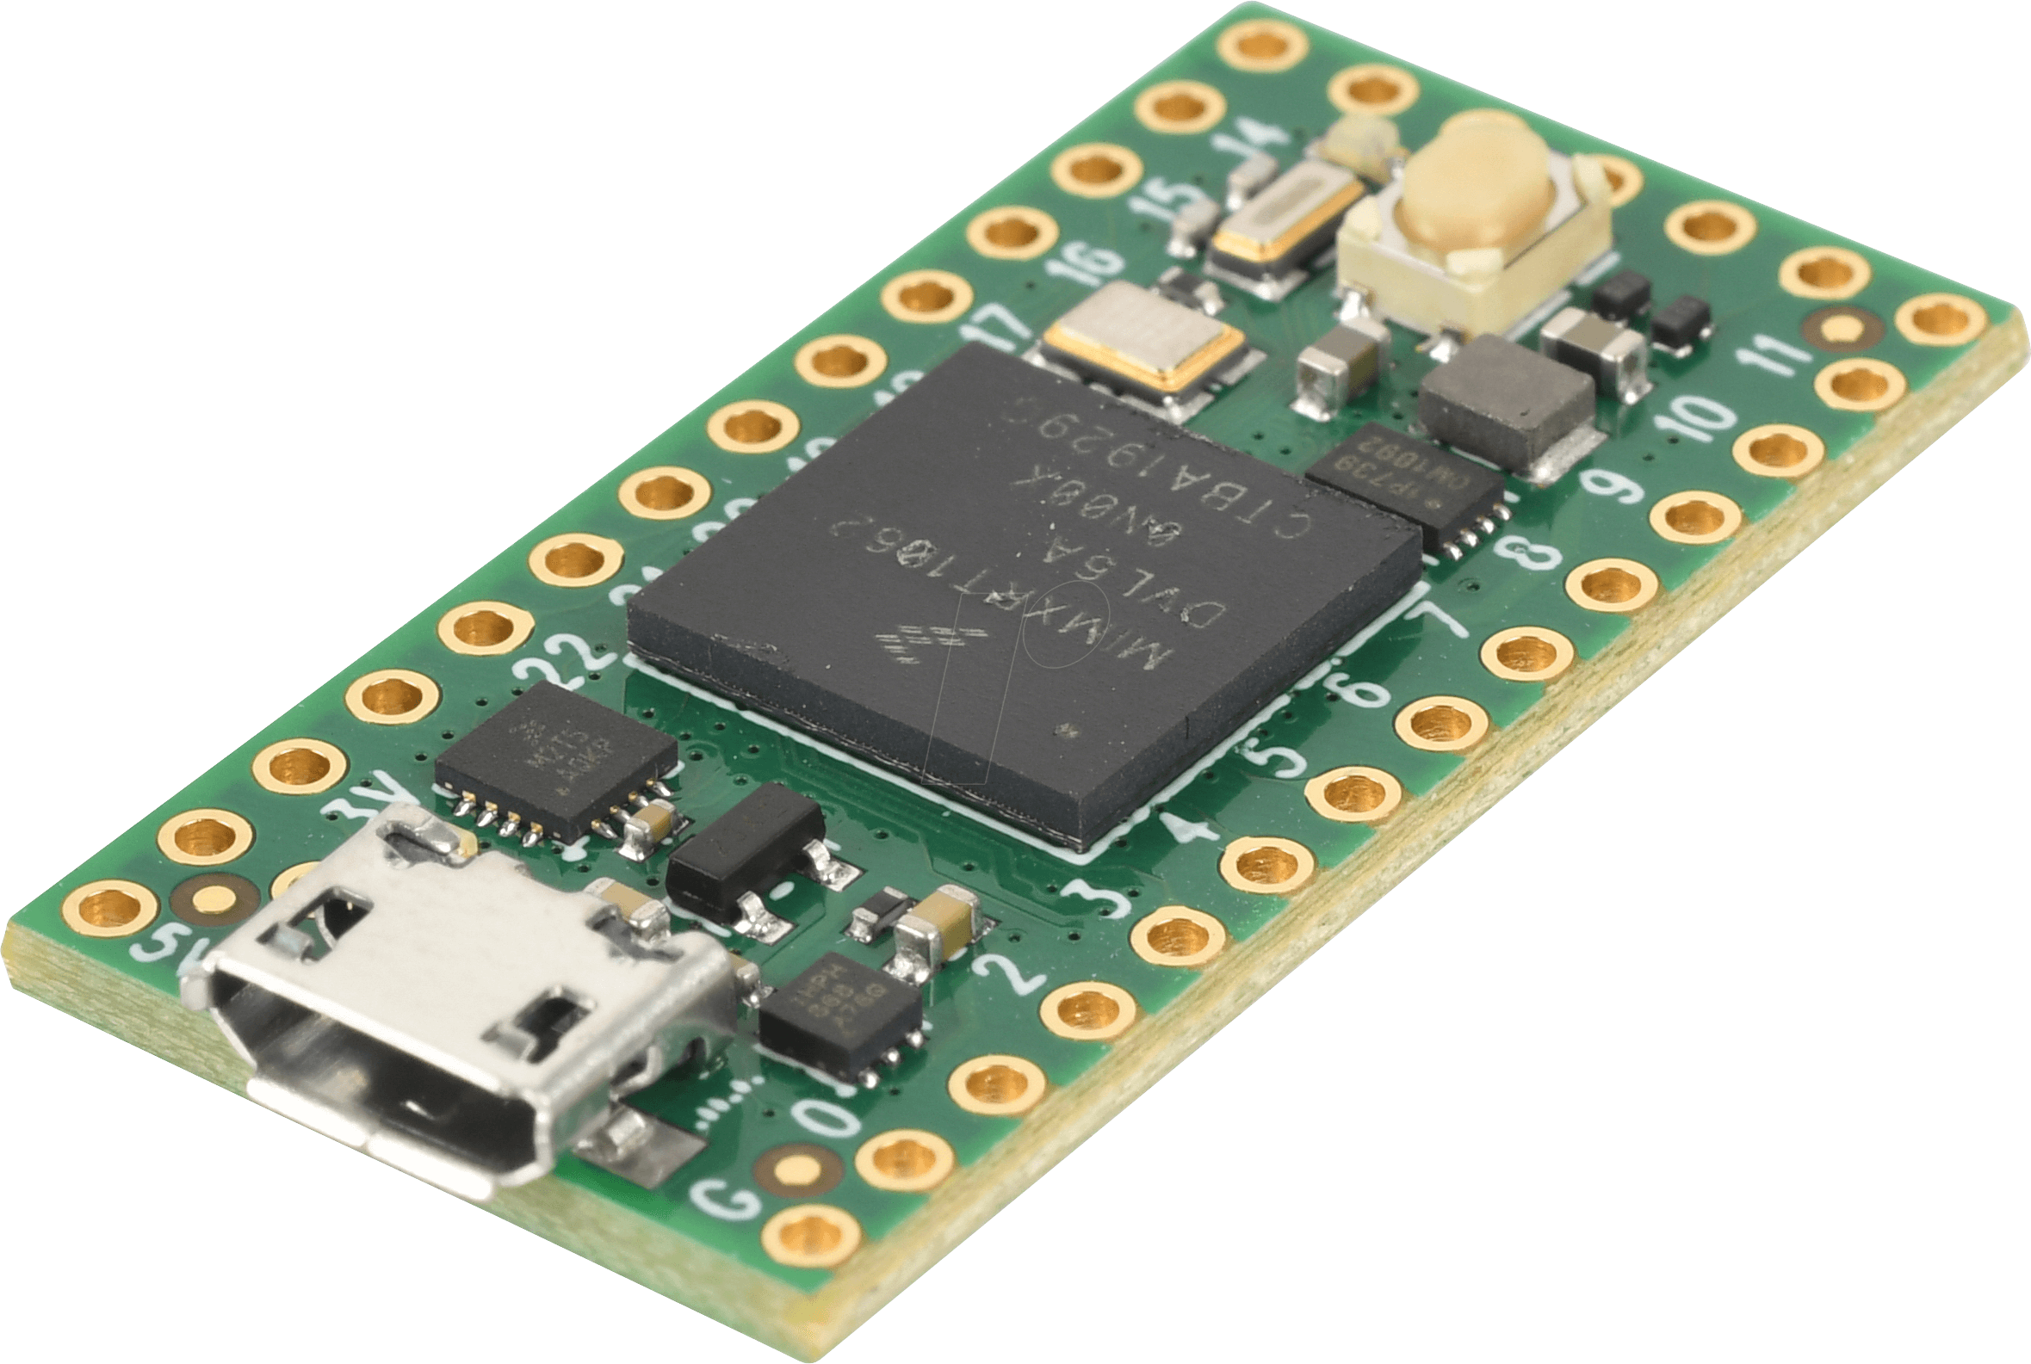

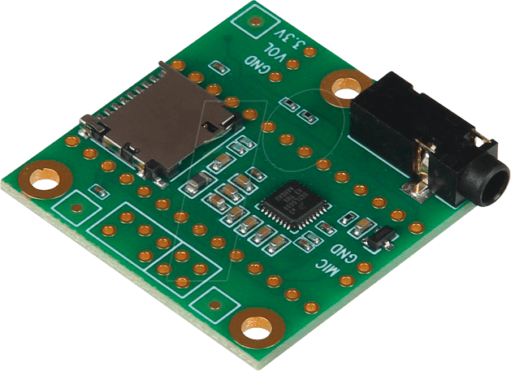
TECHNICAL ENVIRONMENT
HARDWARE
SOFTWARE
TEENSY 4.0
C++
TEENSY AUDIO SHIELD
TEENSY AUDIO LIBRARY

Slide 6
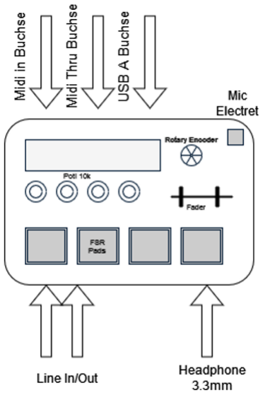
DESIGN IDEA
Rotary encoder to select between samples and to navigate through the menu
Screen to see the Name of the current sample pack and parameter changes.
Potentiometers to change effect values
Velocity sensitive pads to play samples live

Slide 7




PROJECT ORGANIZATION
Discord for communication
JetBrains Space for project structure and task management
Git to share and distribute files and code
To communicate on the go and wake up sleeping team members

Slide 8
TEAM STRUCTURE
DAVID MERTENS
TEAM MIDI
TEAM DISPLAY
TEAM AUDIO
LENA
WILBERTZ
DENNIS
OBERST
ALEXANDER
KOSTENKO
DENNIS
OBERST
LUCAS
HAUPT
TEAMLEADER: DENNIS OBERST

Slide 9
TIMESCEDULE
Stage one finished | Calender Week 20
Stage two finished | Calender Week 28
Case finished | Calender Week 32
Final product tested | Calender Week 35
You are here
Stage One
Stage Two
Case
Product tested
CW-12
CW-20
CW-28
CW-32
CW-35

